Slide 1
Modeling techniques
Gemeente Tilburg

Slide 2
What is dimensional modeling?
Dimensional modeling is a logical design technique for structuring data so such that
It is intuitive for business users
And delivers fast query performance.
Widely accepted as the preferred approach for DW presentation.
Simplicity is fundamental to usefulness.
Allows software to easily navigate databases.

Slide 3
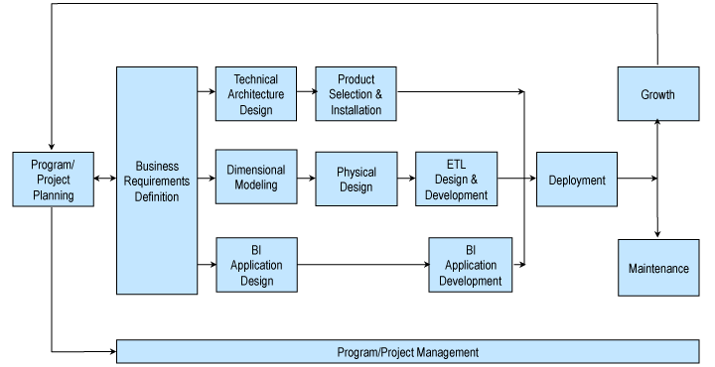
The Kimball lifecycle

Slide 4
What is dimensional modeling?
Definition 1: Dimensional Modeling
Divides world into measurements and context
Measurements are numerical values called facts
Context intuitively divided in clumps called dimensions
Dimensions describe the “who, what, where, when, why, and how” of the facts

Slide 5
What is dimensional modeling?
Definition 2: Dimensional Modeling
A dimensional model consists of a fact table containing measurements surrounded by a halo of dimension tables containing textual context
Known as a star join
Known as a star schema when stored in a relational database (RDBMS)

Slide 6
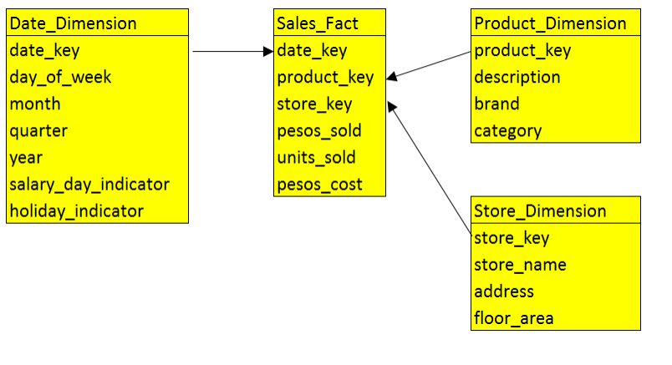
What is dimensional modeling?

Slide 7
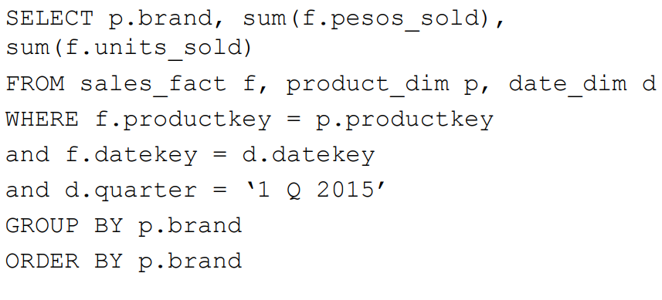
Standard sql query template

Slide 8
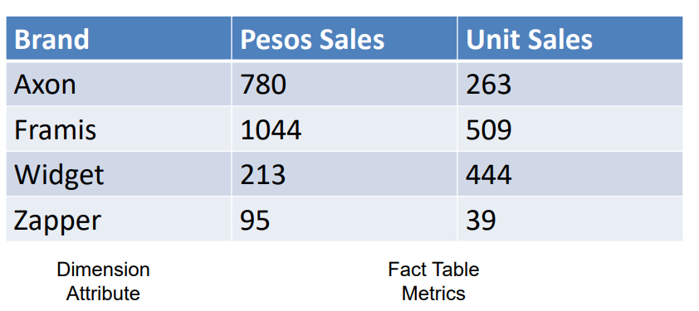
Typical dimensional answer set

Slide 9
Relating a Star Schema to a Report
Drilling down = “give me more detail” by adding a row header (to an existing SQL request)
Real drill down can mix hierarchical and non-hierarchical attributes from all available dimensions

Slide 10
Dimension Attributes Yield Interesting Results
Dimension attributes are the source of most interesting constraints
Examples
Slice sales by product category, by region, by barangay
Analyze sales effectiveness on radio promotions via the AdType attribute in Promotions dimension

Slide 11
Review: Relational Modeling
Widely used method in most databases nowadays
Data is divided into discrete entities
each of which becomes a relational database table called an entity
Models are shown in two forms – logical and physical
Logical models are designed to be independent of any particular RDBMS.
The “tables” in a logical model are called entities. The “columns” are called attributes.

Slide 12
Review: Relational Modeling
Physical models are derived from logical models but are specific to a given RDBMS.
Each entity has a unique identifier known as its primary key.
The primary key consists of one or more attributes/columns.

Slide 13
Normalized Models
Designed to eliminate redundancies. Other than keys, each attribute may appear in only one table.
Design objective: a Third Normal Form (3NF) model.
Modeling business processes results in numerous data entities/tables and a spaghetti-like interweaving of relationships among them.
Some ERP systems have tens of thousands of tables.
Even a small model can be challenging.

Slide 14
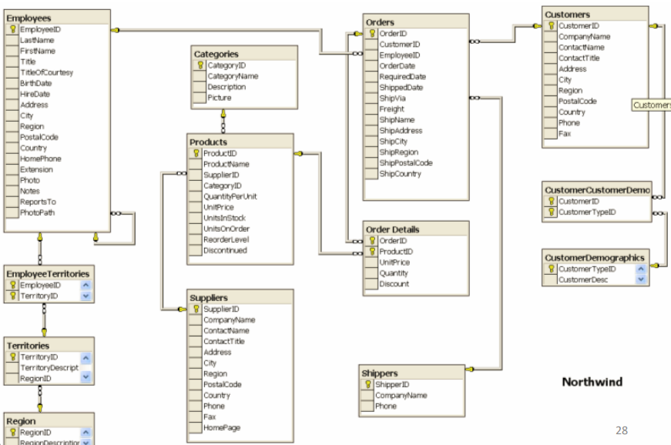
Northwind Normalized Model

Slide 15
Normalized Models NOT Good for DW Systems
Not usable by end-users – too complicated and confusing
Not usable for DW queries – performance too slow (many joins)

Slide 16
Normalized Models Best for Operational Systems
Normalized models essential to good operational systems
Excellent for capturing and understanding the business (rules)
One PO, multiple Line Items
Great for speed when processing individual transactions

Slide 17
Observations on Relational Models
Normalized models look very different from dimensional models
Normalized models confuse business users
Business users see their business in dimensional models
Dimensional models may contain more content than normalized models
History
Enhanced with content from external sources

Slide 18
Two Key Benefits of Dimensional Modeling à la Kimball
Understandability
Model must be easily understood by business users
Yet represent complexities of the business
Performance
Fast response to queries that summarize millions of rows is essential
Limiting models to single level joins rather than multi-level joins
Denormalization has a significant impact on performance

Slide 19
Benefits of Dimensional Models
Predictable, Standard Framework
Users recognize that this is “their business”
Report writers, query tools, and user interfaces can be built into BI tools
Makes user interfaces more understandable
Makes processing more efficient

Slide 20
Benefits of Dimensional Models
Gracefully Extensible to Accommodate Change
Existing tables can be changed by adding new data rows
Data should not have to be reloaded
No query tool or reporting tool has to be reprogrammed
Old BI applications continue to run without yielding different results

Slide 21
Benefits of Dimensional Models
Star Join Schema is Symmetrical
Every dimension is equivalent
All dimensions symmetrically equal entry points to the fact table
No concern about order in selecting tables
Logical design can be done nearly independent of expected query patterns
Future queries not thought of can be accommodated easily
User interfaces, query strategies, and SQL generated are all symmetrical

Slide 22
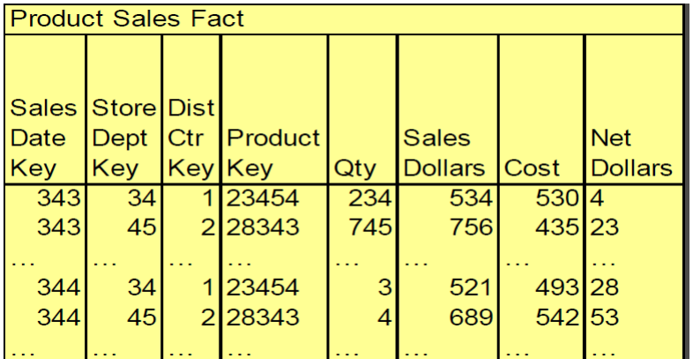
Sample Fact Table Rows

Slide 23
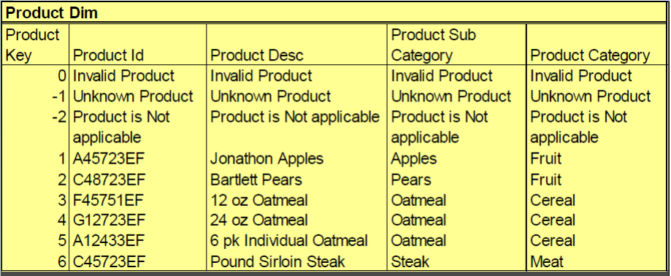
Sample Dimension Table

Slide 24
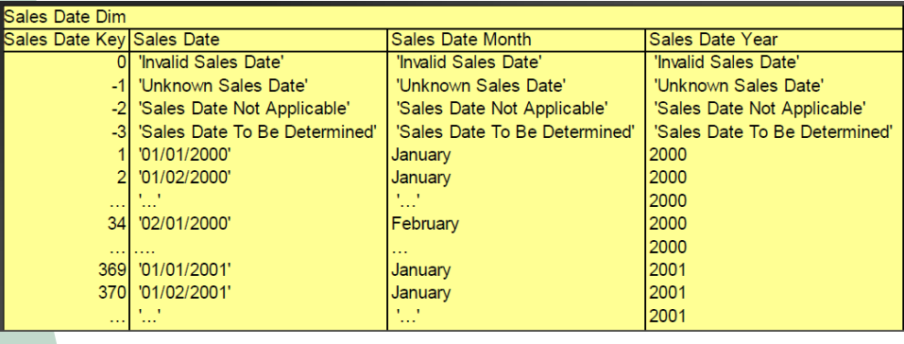
Sample Dimension Table

Slide 25
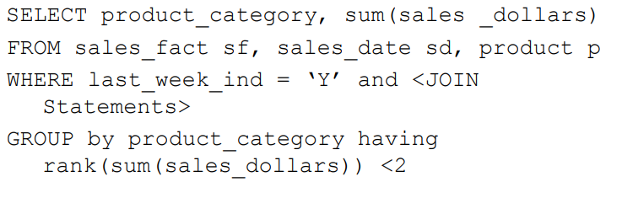
Sample Queries
What was the best selling product category last week?

Slide 26
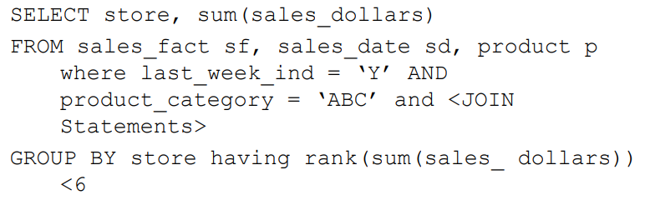
Sample Queries
Which stores sold the most of product category ‘ABC’ last week?

Slide 27
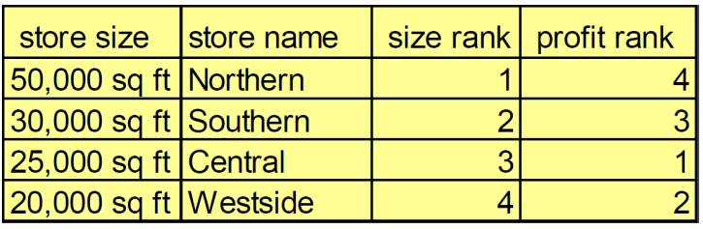
Sample Report
Business Analysis
How did profit last month equate to store size?
Report

Slide 30

Fundamental concepts
Gather Business Requirements and Data Realities
Collaborative Dimensional Modeling Workshops
Four-Step Dimensional Design Process
Select the Business Process
Declare the grain
Identify the dimensions
Identify the facts

Slide 31
Gather Business Requirements and Data Realities
Before launching a dimensional modeling effort, the team needs to understand the needs of the business, as well as the realities of the underlying source data. You uncover the requirements via sessions with business representatives to understand their objectives based on key performance indicators, compelling business issues, decision-making processes, and supporting analytic needs. At the same time, data realities are uncovered by meeting with source system experts and doing high-level data profiling to assess data feasibilities.

Slide 32
Collaborative Dimensional Modeling Workshops
Dimensional models should be designed in collaboration with subject matter experts and data governance representatives from the business. The data modeler is in charge, but the model should unfold via a series of highly interactive workshops with business representatives. These workshops provide another opportunity to flesh out the requirements with the business. Dimensional models should not be designed in isolation by folks who don’t fully understand the business and their needs; collaboration is critical!

Slide 33
Four-Step Dimensional Design Process
The four key decisions made during the design of a dimensional model include:
1. Select the business process.
2. Declare the grain.
3. Identify the dimensions.
4. Identify the facts
The answers to these questions are determined by considering the needs of the business along with the realities of the underlying source data during the collaborative modeling sessions. Following the business process, grain, dimension, and fact declarations, the design team determines the table and column names, sample domain values, and business rules. Business data governance representatives must participate in this detailed design activity to ensure business buy-in.

Slide 34
Business Processes
Business processes are the operational activities performed by your organization, such as taking an order, processing an insurance claim, registering students for a class, or snapshotting every account each month.
Business process events generate or capture performance metrics that translate into facts in a fact table. Most fact tables focus on the results of a single business process. Choosing the process is important because it defines a specific design target and allows the grain, dimensions, and facts to be declared. Each business process corresponds to a row in the enterprise data warehouse bus matrix.

Slide 35
Grain
Declaring the grain is the pivotal step in a dimensional design. The grain establishes exactly what a single fact table row represents. The grain declaration becomes a binding contract on the design. The grain must be declared before choosing dimensions or facts because every candidate dimension or fact must be consistent with the grain.
This consistency enforces a uniformity on all dimensional designs that is critical to BI application performance and ease of use. Atomic grain refers to the lowest level at which data is captured by a given business process. We strongly encourage you to start by focusing on atomic grained data because it withstands the assault of unpredictable user queries; rolled-up summary grains are important for performance tuning, but they pre-suppose the business’s common questions. Each proposed fact table grain results in a separate physical table; different grains must not be mixed in the same fact table.

Slide 36
Dimensions for Descriptive Context
Dimensions provide the “who, what, where, when, why, and how” context surrounding a business process event. Dimension tables contain the descriptive attributes used by BI applications for filtering and grouping the facts.
With the grain of a fact table firmly in mind, all the possible dimensions can be identified. Whenever possible, a dimension should be single valued when associated with a given fact row. Dimension tables are sometimes called the “soul” of the data warehouse because they contain the entry points and descriptive labels that enable the DW/BI system to be leveraged for business analysis.
A disproportionate amount of effort is put into the data governance and development of dimension tables because they are the drivers of the user’s BI experience.

Slide 37
Facts for Measurements
Facts are the measurements that result from a business process event and are almost always numeric. A single fact table row has a one-to-one relationship to a measurement event as described by the fact table’s grain. Thus a fact table corresponds to a physical observable event, and not to the demands of a particular report. Within a fact table, only facts consistent with the declared grain are allowed. For example, in a retail sales transaction, the quantity of a product sold and its extended price are good facts, whereas the store manager’s salary is disallowed.

Slide 38
Star Schemas and OLAP cubes
Star schemas are dimensional structures deployed in a relational database management system (RDBMS). They characteristically consist of fact tables linked to associated dimension tables via primary/foreign key relationships. An online analytical processing (OLAP) cube is a dimensional structure implemented in a multidimensional database; it can be equivalent in content to, or more often derived from, a relational star schema.
An OLAP cube contains dimensional attributes and facts, but it is accessed through languages with more analytic capabilities than SQL, such as XMLA. OLAP cubes are included in this list of basic techniques because an OLAP cube is often the final step in the deployment of a dimensional DW/BI system, or may exist as an aggregate structure based on a more atomic relational star schema.

Slide 39
Grace Extensions to Dimensional Modeling
Dimensional models are resilient when data relationships change. All the following changes can be implemented without altering any existing BI query or application, and without any change in query results.
Facts consistent with the grain of an existing fact table can be added by creating new columns.
Dimensions can be added to an existing fact table by creating new foreign key columns,
presuming they don’t alter the fact table’s grain.
Attributes can be added to an existing dimension table by creating new columns.
The grain of a fact table can be made more atomic by adding attributes to an existing dimension
table, and then restating the fact table at the lower grain, being careful to preserve the existing column names in the fact and dimension tables.

Slide 40
Basic Fact Table Techniques
Fact Table Structure
Additive, Semi-Additive, and Non-Additive Facts
Nulls in Fact Tables
Conformed Facts
Transaction Fact Tables

Slide 41
Fact Table Structure
A fact table contains the numeric measures produced by an operational measurement event in the real world. At the lowest grain, a fact table row corresponds to a measurement event and vice versa.
Thus the fundamental design of a fact table is entirely based on a physical activity and is not influenced by the eventual reports that may be produced.
In addition to numeric measures, a fact table always contains foreign keys for each of its associated dimensions, as well as optional degenerate dimension keys and date/time stamps.
Fact tables are the primary target of computations and dynamic aggregations arising from queries.

Slide 42
Additive, Semi-Additive, and Non-Additive Facts
The numeric measures in a fact table fall into three categories.
The most flexible and useful facts are fully additive; additive measures can be summed across any of the dimensions associated with the fact table.
Semi-additive measures can be summed across some dimensions, but not all; balance amounts are common semi-additive facts because they are additive across all dimensions except time.
Finally, some measures are completely non-additive, such as ratios. A good approach for nonadditive facts is, where possible, to store the fully additive components of the non-additive measure and sum these components into the final answer set before calculating the final non-additive fact. This final calculation is often done in the BI layer or OLAP cube.

Slide 43
Nulls in Fact Tables
Null-valued measurements behave gracefully in fact tables.
The aggregate functions (SUM, COUNT, MIN, MAX, and AVG) all do the “right thing” with null facts.
However, nulls must be avoided in the fact table’s foreign keys because these nulls would automatically cause a referential integrity violation.
Rather than a null foreign key, the associated dimension table must have a default row (and surrogate key) representing the unknown or not applicable condition.

Slide 44
Conformed Facts
If the same measurement appears in separate fact tables, care must be taken to make sure the technical definitions of the facts are identical if they are to be compared or computed together.
If the separate fact definitions are consistent, the conformed facts should be identically named; but if they are incompatible, they should be differently named to alert the business users and BI applications.

Slide 45
Transaction Fact Tables
A row in a transaction fact table corresponds to a measurement event at a point in space and time.
Atomic transaction grain fact tables are the most dimensional and expressive fact tables; this robust dimensionality enables the maximum slicing and dicing of transaction data.
Transaction fact tables may be dense or sparse because rows exist only if measurements take place. These fact tables always contain a foreign key for each associated dimension, and optionally contain precise time stamps and degenerate dimension keys. The measured numeric facts must be consistent with the transaction grain.

Slide 46
Periodic Snapshot Fact Tables
A row in a periodic snapshot fact table summarizes many measurement events occurring over a standard period, such as a day, a week, or a month.
The grain is the period, not the individual transaction. Periodic snapshot fact tables often contain many facts because any measurement event consistent with the fact table grain is permissible.
These fact tables are uniformly dense in their foreign keys because even if no activity takes place during the period, a row is typically inserted in the fact table containing a zero or null for each fact.

Slide 47
Accumulating Snapshot Fact Tables
A row in an accumulating snapshot fact table summarizes the measurement events occurring at predictable steps between the beginning and the end of a process. Pipeline or workflow processes, such as order fulfillment or claim processing, that have a defined start point, standard intermediate steps, and defined end point can be modeled with this type of fact table.
There is a date foreign key in the fact table for each critical milestone in the process. An individual row in an accumulating snapshot fact table, corresponding for instance to a line on an order, is initially inserted when the order line is created. As pipeline progress occurs, the accumulating fact table row is revisited and updated. This consistent updating of accumulating snapshot fact rows is unique among the three types of fact tables. In addition to the date foreign keys associated with each critical process step, accumulating snapshot fact tables contain foreign keys for other dimensions and optionally contain degenerate dimensions. They often include numeric lag measurements consistent with the grain, along with milestone completion counters.

Slide 48
Factless Fact Tables
Although most measurement events capture numerical results, it is possible that the event merely records a set of dimensional entities coming together at a moment in time.
For example, an event of a student attending a class on a given day may not have a recorded numeric fact, but a fact row with foreign keys for calendar day, student, teacher, location, and class is well-defined. Likewise, customer communications are events, but there may be no associated metrics.
Factless fact tables can also be used to analyze what didn’t happen. These queries always have two parts: a factless coverage table that contains all the possibilities of events that might happen and an activity table that contains the events that did happen. When the activity is subtracted from the coverage, the result is the set of events that did not happen

Slide 49
Aggregate Fact Tables or Cubes
Aggregate fact tables are simple numeric rollups of atomic fact table data built solely to accelerate query performance. These aggregate fact tables should be available to the BI layer at the same time as the atomic fact tables so that BI tools smoothly choose the appropriate aggregate level at query time.
This process, known as aggregate navigation, must be open so that every report writer, query tool, and BI application harvests the same performance benefits. A properly designed set of aggregates should behave like database indexes, which accelerate query performance but are not encountered directly by the BI applications or business users. Aggregate fact tables contain foreign keys to shrunken conformed dimensions, as well as aggregated facts created by summing measures from more atomic fact tables. Finally, aggregate OLAP cubes with summarized measures are frequently built in the same way as relational aggregates, but the OLAP cubes are meant to be accessed directly by the business users.

Slide 50
Consolidated Fact Tables
It is often convenient to combine facts from multiple processes together into a single consolidated fact table if they can be expressed at the same grain. For example, sales actuals can be consolidated with sales forecasts in a single fact table to make the task of analyzing actuals versus forecasts simple and fast, as compared to assembling a drill-across application using separate fact tables. Consolidated fact tables add burden to the ETL processing, but ease the analytic burden on the BI applications. They should be considered for cross-process metrics that are frequently analyzed together.
Notes:
Extract, transform, and load (ETL) is the process of combining data from multiple sources into a large, central repository called a data warehouse. ETL uses a set of business rules to clean and organize raw data and prepare it for storage, data analytics, and machine learning (ML).

Slide 51
Basic Dimension Table Techniques
Dimension Table Structure
Dimension Surrogate Keys
Natural, Durable, and Supernatural Keys
Drilling Down
Degenerate Dimensions
Denormalized Flattened Dimensions
Multiple Hierarchies in Dimensions
Flags and Indicators as Textual Dimension Attributes
Null Attributes in Dimensions
Calendar Date Dimensions
Role-Playing Dimensions
Junk Dimensions
Snowflaked Dimensions
Outrigger Dimensions

Slide 52
Dimension Table Structure
Every dimension table has a single primary key column. This primary key is embedded as a foreign key in any associated fact table where the dimension row’s descriptive context is exactly correct for that fact table row.
Dimension tables are usually wide, flat denormalized tables with many low cardinality text attributes. While operational codes and indicators can be treated as attributes, the most powerful dimension attributes are populated with verbose descriptions.
Dimension table attributes are the primary target of constraints and grouping specifications from queries and BI applications. The descriptive labels on reports are typically dimension attribute domain values.

Slide 53
Dimension Surrogate Keys
A dimension table is designed with one column serving as a unique primary key. This primary key cannot be the operational system’s natural key because there will be multiple dimension rows for that natural key when changes are tracked over time. In addition, natural keys for a dimension may be created by more than one source system, and these natural keys may be incompatible or poorly administered. The DW/BI system needs to claim control of the primary keys of all dimensions; rather than using explicit natural keys or natural keys with appended dates, you should create anonymous integer primary keys for every dimension. These dimension surrogate keys are simple integers, assigned in sequence, starting with the value 1, every time a new key is needed. The date dimension is exempt from the surrogate key rule; this highly predictable and stable dimension can use a more meaningful primary key.

Slide 54
Natural, Durable, and Supernatural Keys
Natural keys created by operational source systems are subject to business rules outside the control of the DW/BI system. For instance, an employee number (natural key) may be changed if the employee resigns and then is rehired.
When the data warehouse wants to have a single key for that employee, a new durable key must be created that is persistent and does not change in this situation. This key is sometimes referred to as a durable supernatural key.
The best durable keys have a format that is independent of the original business process and thus should be simple integers assigned in sequence beginning with 1. While multiple surrogate keys may be associated with an employee over time as their profile changes, the durable key never changes.

Slide 55
Drilling Down
Drilling down is the most fundamental way data is analyzed by business users. Drilling down simply means adding a row header to an existing query; the new row header is a dimension attribute appended to the GROUP BY expression in an SQL query. The attribute can come from any dimension attached to the fact table in the query. Drilling down does not require the definition of predetermined hierarchies or drill-down paths.

Slide 56
Degenerate Dimensions
Sometimes a dimension is defined that has no content except for its primary key. For example, when an invoice has multiple line items, the line item fact rows inherit all the descriptive dimension foreign keys of the invoice, and the invoice is left with no unique content.
But the invoice number remains a valid dimension key for fact tables at the line item level. This degenerate dimension is placed in the fact table with the explicit acknowledgment that there is no associated dimension table. Degenerate dimensions are most common with transaction and accumulating snapshot fact tables.

Slide 57
Denormalized Flattened Dimensions
In general, dimensional designers must resist the normalization urges caused by years of operational database designs and instead denormalize the many-to-one fixed depth hierarchies into separate attributes on a flattened dimension row.
Dimension denormalization supports dimensional modeling’s twin objectives of simplicity and speed.

Slide 58
Multiple Hierarchies in Dimensions
Many dimensions contain more than one natural hierarchy. For example, calendar date dimensions may have a day to week to fiscal period hierarchy, as well as a day to month to year hierarchy. Location intensive dimensions may have multiple geographic hierarchies. In all of these cases, the separate hierarchies can gracefully coexist in the same dimension table.

Slide 59
Flags and Indicators as Textual Dimension Attributes
Cryptic abbreviations, true/false flags, and operational indicators should be supplemented in dimension tables with full text words that have meaning when independently viewed.
Operational codes with embedded meaning within the code value should be broken down with each part of the code expanded into its own separate descriptive dimension attribute.

Slide 60
Null Attributes in Dimensions
Null-valued dimension attributes result when a given dimension row has not been fully populated, or when there are attributes that are not applicable to all the dimension’s rows. In both cases, we recommend substituting a descriptive string, such as Unknown or Not Applicable in place of the null value.
Nulls in dimension attributes should be avoided because different databases handle grouping and constraining on nulls inconsistently.

Slide 61
Calendar Date Dimensions
Calendar date dimensions are attached to virtually every fact table to allow navigation of the fact table through familiar dates, months, fiscal periods, and special days on the calendar. You would never want to compute Easter in SQL, but rather want to look it up in the calendar date dimension. The calendar date dimension typically has many attributes describing characteristics such as week number, month name, fiscal period, and national holiday indicator. To facilitate partitioning, the primary key of a date dimension can be more meaningful, such as an integer representing YYYYMMDD, instead of a sequentially-assigned surrogate key. However, the date dimension table needs a special row to represent unknown or to-be-determined dates. Filtering and grouping should be based on the date dimension’s attributes, not the smart key. When further precision is needed, a separate date/time stamp can be added to the fact table. The date/time stamp is not a foreign key to a dimension table, but rather is a standalone column. If business users constrain or group on time-ofday attributes, such as day part grouping or shift number, then you would add a separate time-of-day dimension foreign key to the fact table.

Slide 62
Role-Playing Dimensions
A single physical dimension can be referenced multiple times in a fact table, with each reference linking to a logically distinct role for the dimension. For instance, a fact table can have several dates, each of which is represented by a foreign key to the date dimension. It is essential that each foreign key refers to a separate view of the date dimension so that the references are independent. These separate dimension views (with unique attribute column names) are called roles.

Slide 63
Junk Dimensions
Transactional business processes typically produce a number of miscellaneous, low-cardinality flags and indicators. Rather than making separate dimensions for each flag and attribute, you can create a single junk dimension combining them together.
This dimension, frequently labeled as a transaction profile dimension in a schema, does not need to be the Cartesian product of all the attributes’ possible values, but should only contain the combination of values that actually occur in the source data.

Slide 64
Snowflaked Dimensions
When a hierarchical relationship in a dimension table is normalized, low-cardinality attributes appear as secondary tables connected to the base dimension table by an attribute key. When this process is repeated with all the dimension table’s hierarchies, a characteristic multilevel structure is created that is called a snowflake.
Although the snowflake represents hierarchical data accurately, you should avoid snowflakes because it is difficult for business users to understand and navigate snowflakes. They can also negatively impact query performance. A flattened denormalized dimension table contains exactly the same information as a snowflaked dimension.

Slide 65
Outrigger Dimensions
A dimension can contain a reference to another dimension table. For instance, a bank account dimension can reference a separate dimension representing the date the account was opened. These secondary dimension references are called outrigger dimensions.
Outrigger dimensions are permissible, but should be used sparingly. In most cases, the correlations between dimensions should be demoted to a fact table, where both dimensions are represented as separate foreign keys.

Slide 66
Exercise: northwind traders

Slide 67
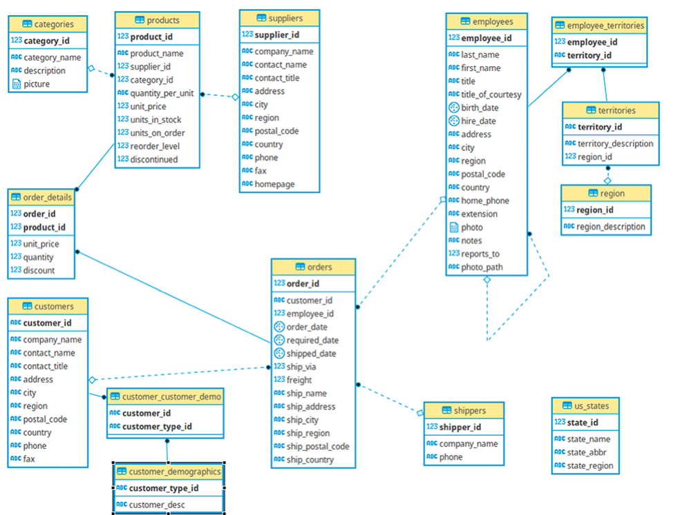

Slide 68
Integration via Conformed Dimensions
One of the marquee successes of the dimensional modeling approach has been to define a simple but powerful recipe for integrating data from different business processes.

Slide 69
Conformed Dimensions
Dimension tables conform when attributes in separate dimension tables have the same column names and domain contents. Information from separate fact tables can be combined in a single report by using conformed dimension attributes that are associated with each fact table.
When a conformed attribute is used as the row header (that is, the grouping column in the SQL query), the results from the separate fact tables can be aligned on the same rows in a drill-across report. This is the essence of integration in an enterprise DW/ BI system. Conformed dimensions, defined once in collaboration with the business’s data governance representatives, are reused across fact tables; they deliver both analytic consistency and reduced future development costs because the wheel is not repeatedly re-created

Slide 70
Shrunken Rollup Dimensions
Shrunken dimensions are conformed dimensions that are a subset of rows and /or columns of a base dimension.
Shrunken rollup dimensions are required when constructing aggregate fact tables. They are also necessary for business processes that naturally capture data at a higher level of granularity, such as a forecast by month and brand (instead of the more atomic date and product associated with sales data).
Another case of conformed dimension subsetting occurs when two dimensions are at the same level of detail, but one represents only a subset of rows.

Slide 71
Drilling Across
Drilling across simply means making separate queries against two or more fact tables where the row headers of each query consist of identical conformed attributes. The answer sets from the two queries are aligned by performing a sort-merge operation on the common dimension attribute row headers. BI tool vendors refer to this functionality by various names, including stitch and multipass query.

Slide 72
Value Chain
A value chain identifies the natural flow of an organization’s primary business processes.
For example, a retailer’s value chain may consist of purchasing to ware- housing to retail sales. A general ledger value chain may consist of budgeting to commitments to payments.
Operational source systems typically produce transactions or snapshots at each step of the value chain. Because each process produces unique metrics at unique time intervals with unique granularity and dimensionality, each process typically spawns at least one atomic fact table.

Slide 73
Enterprise Data Warehouse Bus Architecture
The enterprise data warehouse bus architecture provides an incremental approach to building the enterprise DW/BI system. This architecture decomposes the DW/ BI planning process into manageable pieces by focusing on business processes, while delivering integration via standardized conformed dimensions that are reused across processes.
It provides an architectural framework, while also decomposing the program to encourage manageable agile implementations corresponding to the rows on the enterprise data warehouse bus matrix. The bus architecture is technology and database platform independent; both relational and OLAP dimensional structures can participate.

Slide 74
Enterprise Data Warehouse Bus Matrix
The enterprise data warehouse bus matrix is the essential tool for designing and communicating the enterprise data warehouse bus architecture. The rows of the matrix are business processes and the columns are dimensions. The shaded cells of the matrix indicate whether a dimension is associated with a given business process. The design team scans each row to test whether a candidate dimension is well-defined for the business process and also scans each column to see where a dimension should be conformed across multiple business processes. Besides the technical design considerations, the bus matrix is used as input to prioritize DW/BI projects with business management as teams should implement one row of the matrix at a time.
The detailed implementation bus matrix is a more granular bus matrix where each business process row has been expanded to show specific fact tables or OLAP cubes. At this level of detail, the precise grain statement and list of facts can be documented.

Slide 75
Opportunity/Stakeholder Matrix
After the enterprise data warehouse bus matrix rows have been identified, you can draft a different matrix by replacing the dimension columns with business functions, such as marketing, sales, and finance, and then shading the matrix cells to indicate which business functions are interested in which business process rows. The opportunity/stakeholder matrix helps identify which business groups should be invited to the collaborative design sessions for each process-centric row.

Slide 76
Slowly Changing Dimension Techniques
Type 0: Retain Original
Type 1: Overwrite
Type 2: Add New Row
Type 3: Add New Attribute
Type 4: Add Mini-Dimension
Type 5: Add Mini-Dimension and Type 1 Outrigger
Type 6: Add Type 1 Attributes to Type 2 Dimension
Type 7: Dual Type 1 and Type 2 Dimensions

Slide 77
Type 0: Retain Original
With slowly changing dimension type 0, the dimension attribute value never changes, so facts are always grouped by this original value. Type 0 is appropriate for any attribute labeled “original,” such as a customer’s original credit score or a durable identifier. It also applies to most attributes in a date dimension.

Slide 78
Type 1: Overwrite
With slowly changing dimension type 1, the old attribute value in the dimension row is overwritten with the new value; type 1 attributes always reflects the most recent assignment, and therefore this technique destroys history. Although this approach is easy to implement and does not create additional dimension rows, you must be careful that aggregate fact tables and OLAP cubes affected by this change are recomputed.

Slide 79
Type 2: Add New Row
Slowly changing dimension type 2 changes add a new row in the dimension with the updated attribute values. This requires generalizing the primary key of the dimension beyond the natural or durable key because there will potentially be multiple rows describing each member.
When a new row is created for a dimension member, a new primary surrogate key is assigned and used as a foreign key in all fact tables from the moment of the update until a subsequent change creates a new dimension key and updated dimension row. A minimum of three additional columns should be added to the dimension row with type 2 changes: 1) row effective date or date/time stamp; 2) row expiration date or date/time stamp; and 3) current row indicator.

Slide 80
Type 3: Add New Attribute
Slowly changing dimension type 3 changes add a new attribute in the dimension to preserve the old attribute value; the new value overwrites the main attribute as in a type 1 change.
This kind of type 3 change is sometimes called an alternate reality. A business user can group and filter fact data by either the current value or alternate reality. This slowly changing dimension technique is used relatively infrequently.

Slide 81
Type 4: Add Mini-Dimension
Slowly changing dimension type 4 is used when a group of attributes in a dimension rapidly changes and is split off to a mini-dimension.
This situation is sometimes called a rapidly changing monster dimension. Frequently used attributes in multimillion-row dimension tables are mini-dimension design candidates, even if they don’t frequently change.
The type 4 mini-dimension requires its own unique primary key; the primary keys of both the base dimension and mini-dimension are captured in the associated fact tables.

Slide 82
Type 5: Add Mini-Dimension and Type 1 Outrigger
Slowly changing dimension type 5 is used to accurately preserve historical attribute values, plus report historical facts according to current attribute values. Type 5 builds on the type 4 mini-dimension by also embedding a current type 1 reference to the mini-dimension in the base-dimension.
This enables the currently-assigned mini- dimension attributes to be accessed along with the others in the base dimension without linking through a fact table. Logically, you’d represent the base dimension and mini-dimension outrigger as a single table in the presentation area. The ETL team must overwrite this type 1 mini-dimension reference whenever the current mini-dimension assignment changes.

Slide 83
Type 6: Add Type 1 Attributes to Type 2 Dimension
Like type 5, slowly changing dimension type 6 also delivers both historical and current dimension attribute values.
Type 6 builds on the type 2 technique by also embedding current type 1 versions of the same attributes in the dimension row so that fact rows can be filtered or grouped by either the type 2 attribute value in effect when the measurement occurred or the attribute’s current value.
In this case, the type 1 attribute is systematically overwritten on all rows associated with a particular durable key whenever the attribute is updated.

Slide 84
Type 7: Dual Type 1 and Type 2 Dimensions
Slowly changing dimension type 7 is the final hybrid technique used to support both as-was and as-is reporting. A fact table can be accessed through a dimension modeled both as a type 1 dimension showing only the most current attribute values, or as a type 2 dimension showing correct contemporary historical profiles. The same dimension table enables both perspectives.
Both the durable key and primary surrogate key of the dimension are placed in the fact table. For the type 1 perspective, the current flag in the dimension is constrained to be current, and the fact table is joined via the durable key. For the type 2 perspective, the current flag is not constrained, and the fact table is joined via the surrogate primary key. These two perspectives would be deployed as separate views to the BI applications.

Slide 85
Dealing with Dimension Hierarchies
Fixed Depth Positional Hierarchies
Slightly Ragged/Variable Depth Hierarchies
Ragged/Variable Depth Hierarchies

Slide 86
Fixed Depth Positional Hierarchies
A fixed depth hierarchy is a series of many-to-one relationships, such as product to brand to category to department. When a fixed depth hierarchy is defined and the hierarchy levels have agreed upon names, the hierarchy levels should appear as separate positional attributes in a dimension table.
A fixed depth hierarchy is by far the easiest to understand and navigate as long as the above criteria are met. It also delivers predictable and fast query performance. When the hierarchy is not a series of many-to-one relationships or the number of levels varies such that the levels do not have agreed upon names, a ragged hierarchy technique must be used.

Slide 87
Slightly Ragged/Variable Depth Hierarchies
Slightly ragged hierarchies don’t have a fixed number of levels, but the range in depth is small. Geographic hierarchies often range in depth from perhaps three levels to six levels.
Rather than using the complex machinery for unpredictably variable hierarchies, you can force-fit slightly ragged hierarchies into a fixed depth positional design with separate dimension attributes for the maximum number of levels, and then populate the attribute value based on rules from the business.

Slide 88
Ragged/Variable Depth Hierarchies
Ragged hierarchies of indeterminate depth are difficult to model and query in a relational database. Although SQL extensions and OLAP access languages provide some support for recursive parent/ child relationships, these approaches have limitations.
With SQL extensions, alternative ragged hierarchies cannot be substituted at query time, shared ownership structures are not supported, and time varying ragged hierarchies are not supported. All these objections can be overcome in relational databases by modeling a ragged hierarchy with a specially constructed bridge table. This bridge table contains a row for every possible path in the ragged hierarchy and enables all forms of hierarchy traversal to be accomplished with standard SQL rather than using special language extensions.

Slide 89
Ragged/Variable Depth Hierarchies
The use of a bridge table for ragged variable depth hierarchies can be avoided by implementing a pathstring attribute in the dimension.
For each row in the dimension, the pathstring attribute contains a specially encoded text string containing the complete path description from the supreme node of a hierarchy down to the node described by the particular dimension row.
Many of the standard hierarchy analysis requests can then be handled by standard SQL, without resorting to SQL language extensions. However, the pathstring approach does not enable rapid substitution of alternative hierarchies or shared ownership hierarchies. The pathstring approach may also be vulnerable to structure changes in the ragged hierarchy that could force the entire hierarchy to be relabeled.

Slide 90
Retail sales use case
The best way to understand the principles of dimensional modeling is to work through a series of tangible examples. By visualizing real cases, you hold the particular design challenges and solutions in your mind more effectively than if they are presented abstractly. This book uses case studies from a range of businesses to help move past the idiosyncrasies of your own environment and reinforce dimensional modeling best practices.

Slide 91
Four-Step Dimensional Design Process
We will approach the design of a dimensional model by consistently considering four steps, as the following sections discuss in more detail.

Slide 92
Step 1: Select the Business Process
A business process is a low-level activity performed by an organization, such as taking orders, invoicing, receiving payments, handling service calls, registering students, performing a medical procedure, or processing claims. To identify your organization’s business processes, it’s helpful to understand several common characteristics:
Business processes are frequently expressed as action verbs because they represent activities that the business performs. The companion dimensions describe descriptive context associated with each business process event.
Business processes are typically supported by an operational system, such as the billing or purchasing system.
Business processes generate or capture key performance metrics. Sometimes the metrics are a direct result of the business process; the measurements are derivations at other times. Analysts invariably want to scrutinize and evaluate these metrics by a seemingly limitless combination of fi lters and constraints.
Business processes are usually triggered by an input and result in output metrics. In many organizations, there’s a series of processes in which the outputs from one process become the inputs to the next. In the parlance of a dimensional modeler, this series of processes results in a series of fact tables.

Slide 93
Step 2: Declare the Grain
Declaring the grain means specifying exactly what an individual fact table row represents. The grain conveys the level of detail associated with the fact table measurements. It provides the answer to the question, “How do you describe a single row in the fact table?” The grain is determined by the physical realities of the operational system that captures the business process’s events. Example grain declarations include:
One row per scan of an individual product on a customer’s sales transaction
One row per line item on a bill from a doctor
One row per individual boarding pass scanned at an airport gate
One row per daily snapshot of the inventory levels for each item in a warehouse
One row per bank account each month

Slide 94
Step 2: Declare the Grain
These grain declarations are expressed in business terms. Perhaps you were expecting the grain to be a traditional declaration of the fact table’s primary key. Although the grain ultimately is equivalent to the primary key, it’s a mistake to list a set of dimensions and then assume this list is the grain declaration. Whenever possible, you should express the grain in business terms. Dimensional modelers sometimes try to bypass this seemingly unnecessary step of the four-step design process. Please don’t! Declaring the grain is a critical step that can’t be taken lightly

Slide 95
Step 2: Declare the Grain
It is extremely important that everyone on the design team reaches agreement on the fact table’s granularity. Having said this, you may discover in steps 3 or 4 of the design process that the grain statement is wrong. This is okay, but then you must return to step 2, restate the grain correctly, and revisit steps 3 and 4 again.

Slide 96
Step 3: Identify the Dimensions
Dimensions fall out of the question, “How do business people describe the data resulting from the business process measurement events?” You need to decorate fact tables with a robust set of dimensions representing all possible descriptions that take on single values in the context of each measurement. If you are clear about the grain, the dimensions typically can easily be identified as they represent the “who, what, where, when, why, and how” associated with the event. Examples of common dimensions include date, product, customer, employee, and facility. With the choice of each dimension, you then list all the discrete, text-like attributes that flesh out each dimension table.

Slide 97
Step 4: Identify the Facts
Facts are determined by answering the question, “What is the process measuring?” Business users are keenly interested in analyzing these performance metrics. All candidate facts in a design must be true to the grain defined in step 2. Facts that clearly belong to a different grain must be in a separate fact table. Typical facts are numeric additive figures, such as quantity ordered or dollar cost amount.

Slide 98
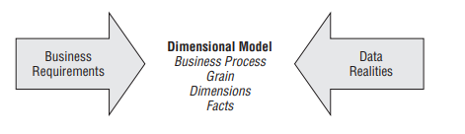
Step 4: Identify the Facts
You need to consider both your business users’ requirements and the realities of your source data in tandem to make decisions regarding the four steps. We strongly encourage you to resist the temptation to model the data by looking at source data alone. It may be less intimidating to dive into the data rather than interview a business person; however, the data is no substitute for business user input. Unfortunately, many organizations have attempted this pathof-least-resistance data-driven approach but without much success.

Slide 99
Retail Case Study
Imagine you work in the headquarters of a large grocery chain. The business has 100 grocery stores spread across five states. Each store has a full complement of departments, including grocery, frozen foods, dairy, meat, produce, bakery, floral, and health/beauty aids. Each store has approximately 60,000 individual products, called stock keeping units (SKUs), on its shelves.
Data is collected at several interesting places in a grocery store. Some of the most useful data is collected at the cash registers as customers purchase products. The pointof-sale (POS) system scans product barcodes at the cash register, measuring consumer takeaway at the front door of the grocery store, as illustrated in the cash register receipt. Other data is captured at the store’s back door where vendors make deliveries.

Slide 100
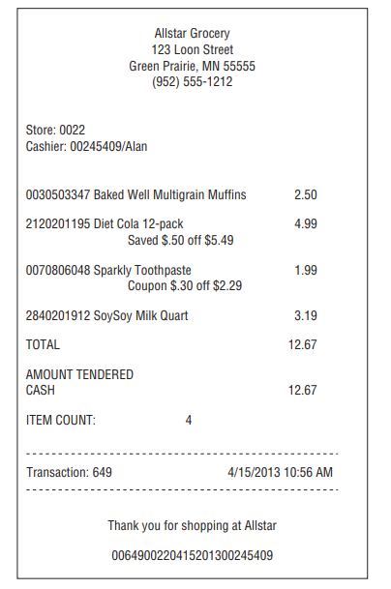

Slide 101
At the grocery store, management is concerned with the logistics of ordering, stocking, and selling products while maximizing profit. The profit ultimately comes from charging as much as possible for each product, lowering costs for product acquisition and overhead, and at the same time attracting as many customers as possible in a highly competitive environment.
Some of the most significant management decisions have to do with pricing and promotions. Both store management and headquarters marketing spend a great deal of time tinkering with pricing and promotions. Promotions in a grocery store include temporary price reductions, ads in newspapers and newspaper inserts, displays in the grocery store, and coupons. The most direct and effective way to create a surge in the volume of product sold is to lower the price dramatically.
A 50-cent reduction in the price of paper towels, especially when coupled with an ad and display, can cause the sale of the paper towels to jump by a factor of 10. Unfortunately, such a big price reduction usually is not sustainable because the towels probably are being sold at a loss. As a result of these issues, the visibility of all forms of promotion is an important part of analyzing the operations of a grocery store.

Slide 102
Step 1: Select the Business Process
The first step in the design is to decide what business process to model by combining an understanding of the business requirements with an understanding of the available source data.
NOTE The first DW/BI project should focus on the business process that is both the most critical to the business users, as well as the most feasible. Feasibility covers a range of considerations, including data availability and quality, as well as organizational readiness.

Slide 103
Step 1: Select the Business Process
In our retail case study, management wants to better understand customer purchases as captured by the POS system. Thus the business process you’re modeling is POS retail sales transactions. This data enables the business users to analyze which products are selling in which stores on which days under what promotional conditions in which transactions.

Slide 104
Step 2: Declare the Grain
After the business process has been identified, the design team faces a serious decision about the granularity. What level of data detail should be made available in the dimensional model?
Tackling data at its lowest atomic grain makes sense for many reasons. Atomic data is highly dimensional. The more detailed and atomic the fact measurement, the more things you know for sure. All those things you know for sure translate into dimensions. In this regard, atomic data is a perfect match for the dimensional approach.
Atomic data provides maximum analytic flexibility because it can be constrained and rolled up in every way possible. Detailed data in a dimensional model is poised and ready for the ad hoc attack by business users.

Slide 105
Of course, you could declare a more summarized granularity representing an aggregation of the atomic data. However, as soon as you select a higher level grain, you limit yourself to fewer and/or potentially less detailed dimensions. The less granular model is immediately vulnerable to unexpected user requests to drill down into the details. Users inevitably run into an analytic wall when not given access to the atomic data.
Although aggregated data plays an important role for performance tuning, it is not a substitute for giving users access to the lowest level details; users can easily summarize atomic data, but it’s impossible to create details from summary data. Unfortunately, some industry pundits remain confused about this point. They claim dimensional models are only appropriate for summarized data and then criticize the dimensional modeling approach for its supposed need to anticipate the business question. This misunderstanding goes away when detailed, atomic data is made available in a dimensional model.

Slide 106

In our case study, the most granular data is an individual product on a POS transaction, assuming the POS system rolls up all sales for a given product within a shopping cart into a single line item.
Although users probably are not interested in analyzing single items associated with a specific POS transaction, you can’t predict all the ways they’ll want to cull through that data.
For example, they may want to understand the difference in sales on Monday versus Sunday. Or they may want to assess whether it’s worthwhile to stock so many individual sizes of certain brands. Or they may want to understand how many shoppers took advantage of the 50-cents-off promotion on shampoo. Or they may want to determine the impact of decreased sales when a competitive diet soda product was promoted heavily. Although none of these queries calls for data from one specific transaction, they are broad questions that require detailed data sliced in precise ways. None of them could have been answered if you elected to provide access only to summarized data.

Slide 107
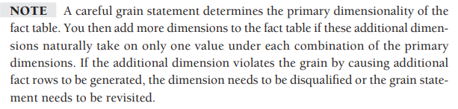
Step 3: Identify the Dimensions
After the grain of the fact table has been chosen, the choice of dimensions is straightforward. The product and transaction fall out immediately.
Within the framework of the primary dimensions, you can ask whether other dimensions can be attributed to the POS measurements, such as the date of the sale, the store where the sale occurred, the promotion under which the product is sold, the cashier who handled the sale, and potentially the method of payment. We express this as another design principle.

Slide 108
The following descriptive dimensions apply to the case: date, product, store, promotion, cashier, and method of payment. In addition, the POS transaction ticket number is included as a special dimension, as described in the section “Degenerate Dimensions for Transaction Numbers” later in this case. Before fleshing out the dimension tables with descriptive attributes, let’s complete the final step of the four-step process. You don’t want to lose sight of the forest for the trees at this stage of the design.

Slide 109
Step 4: Identify the Facts
The fourth and final step in the design is to make a careful determination of which facts will appear in the fact table. Again, the grain declaration helps anchor your thinking. Simply put, the facts must be true to the grain: the individual product line item on the POS transaction in this case. When considering potential facts, you may again discover adjustments need to be made to either your earlier grain assumptions or choice of dimensions.

Slide 110
The facts collected by the POS system include the sales quantity (for example, the number of cans of chicken noodle soup), per unit regular, discount, and net paid prices, and extended discount and sales dollar amounts. The extended sales dollar amount equals the sales quantity multiplied by the net unit price. Likewise, the extended discount dollar amount is the sales quantity multiplied by the unit discount amount. Some sophisticated POS systems also provide a standard dollar cost for the product as delivered to the store by the vendor. Presuming this cost fact is readily available and doesn’t require a heroic activity-based costing initiative, you can include the extended cost amount in the fact table.

Slide 111
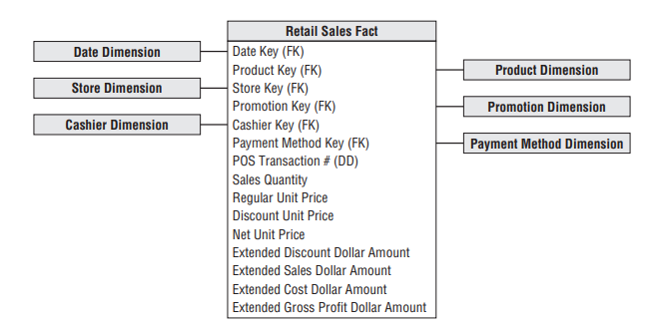
Four of the facts, sales quantity and the extended discount, sales, and cost dollar amounts, are beautifully additive across all the dimensions. You can slice and dice the fact table by the dimension attributes with impunity, and every sum of these four facts is valid and correct.

Slide 112
Derived Facts
You can compute the gross profit by subtracting the extended cost dollar amount from the extended sales dollar amount, or revenue. Although computed, gross profit is also perfectly additive across all the dimensions; you can calculate the gross profit of any combination of products sold in any set of stores on any set of days. Dimensional modelers sometimes question whether a calculated derived fact should be stored in the database. We generally recommend it be stored physically. In this case study, the gross profit calculation is straightforward, but storing it means it’s computed consistently in the ETL process, eliminating the possibility of user calculation errors. The cost of a user incorrectly representing gross profit overwhelms the minor incremental storage cost. Storing it also ensures all users and BI reporting applications refer to gross profit consistently. Because gross profit can be calculated from adjacent data within a single fact table row, some would argue that you should perform the calculation in a view that is indistinguishable from the table. This is a reasonable approach if all users access the data via the view and no users with ad hoc query tools can sneak around the view to get at the physical table

Slide 113
Views are a reasonable way to minimize user error while saving on storage, but the DBA must allow no exceptions to accessing the data through the view. Likewise, some organizations want to perform the calculation in the BI tool. Again, this works if all users access the data using a common tool, which is seldom the case in our experience. However, sometimes non-additive metrics on a report such as percentages or ratios must be computed in the BI application because the calculation cannot be precalculated and stored in a fact table. OLAP cubes excel in these situations.

Slide 114
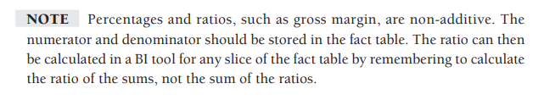
Non-Additive Facts
Gross margin can be calculated by dividing the gross profi t by the extended sales dollar revenue. Gross margin is a non-additive fact because it can’t be summarized along any dimension. You can calculate the gross margin of any set of products, stores, or days by remembering to sum the revenues and costs respectively before dividing.

Slide 115
Unit price is another non-additive fact. Unlike the extended amounts in the fact table, summing unit price across any of the dimensions results in a meaningless, nonsensical number. Consider this simple example: You sold one widget at a unit price of $1.00 and four widgets at a unit price of 50 cents each. You could sum the sales quantity to determine that five widgets were sold. Likewise, you could sum the sales dollar amounts ($1.00 and $2.00) to arrive at a total sales amount of $3.00. However, you can’t sum the unit prices ($1.00 and 50 cents) and declare that the total unit price is $1.50. Similarly, you shouldn’t announce that the average unit price is 75 cents. The properly weighted average unit price should be calculated by taking the total sales amount ($3.00) and dividing by the total quantity (five widgets) to arrive at a 60 cent average unit price. You’d never arrive at this conclusion by looking at the unit price for each transaction line in isolation. To analyze the average price, you must add up the sales dollars and sales quantities before dividing the total dollars by the total quantity sold. Fortunately, many BI tools perform this function correctly. Some question whether non-additive facts should be physically stored in a fact table. This is a legitimate question given their limited analytic value, aside from printing individual values on a report or applying a filter directly on the fact, which are both atypical. In some situations, a fundamentally non-additive fact such as a temperature is supplied by the source system. These non-additive facts may be averaged carefully over many records, if the business analysts agree that this makes sense.

Slide 116
Transaction Fact Tables
Transactional business processes are the most common. The fact tables representing these processes share several characteristics:
The grain of atomic transaction fact tables can be succinctly expressed in the context of the transaction, such as one row per transaction or one row per transaction line.
Because these fact tables record a transactional event, they are often sparsely populated. In our case study, we certainly wouldn’t sell every product inevery shopping cart.
Even though transaction fact tables are unpredictably and sparsely populated, they can be truly enormous. Most billion and trillion row tables in a data warehouse are transaction fact tables.
Transaction fact tables tend to be highly dimensional.
The metrics resulting from transactional events are typically additive as long as they have been extended by the quantity amount, rather than capturing per unit metrics.

Slide 117
At this early stage of the design, it is often helpful to estimate the number of rows in your largest table, the fact table. In this case study, it simply may be a matter of talking with a source system expert to understand how many POS transaction line items are generated on a periodic basis. Retail traffic fluctuates significantly from day to day, so you need to understand the transaction activity over a reasonable period of time. Alternatively, you could estimate the number of rows added to the fact table annually by dividing the chain’s annual gross revenue by the average item selling price. Assuming that gross revenues are $4 billion per year and that the average price of an item on a customer ticket is $2.00, you can calculate that there are approximately 2 billion transaction line items per year. This is a typical engineer’s estimate that gets you surprisingly close to sizing a design directly from your armchair. As designers, you always should be triangulating to determine whether your calculations are reasonable.

Slide 118
Dimension Table Details
Now that we’ve walked through the four-step process, let’s return to the dimension tables and focus on populating them with robust attributes.

Slide 119
Date Dimension
The date dimension is a special dimension because it is the one dimension nearly guaranteed to be in every dimensional model since virtually every business process captures a time series of performance metrics. In fact, date is usually the first dimension in the underlying partitioning scheme of the database so that the successive time interval data loads are placed into virgin territory on the disk. For readers of the first edition of The Data Warehouse Toolkit (Wiley, 1996), this dimension was referred to as the time dimension. However, for more than a decade, we’ve used the “date dimension” to mean a daily grained dimension table. This helps distinguish between date and time-of-day dimensions. Unlike most of the other dimensions, you can build the date dimension table in advance. You may put 10 or 20 years of rows representing individual days in the table, so you can cover the history you have stored, as well as several years in the future. Even 20 years’ worth of days is only approximately 7,300 rows, which is a relatively small dimension table. For a daily date dimension table in a retail environment

Slide 120
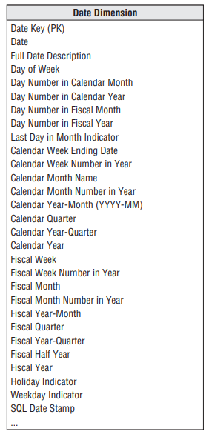

Slide 121
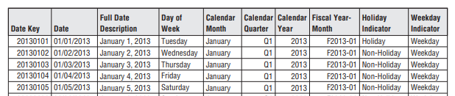
Each column in the date dimension table is defined by the particular day that the row represents. The day-of-week column contains the day’s name, such as Monday. This column would be used to create reports comparing Monday business with Sunday business. The day number in calendar month column starts with 1 at the beginning of each month and runs to 28, 29, 30, or 31 depending on the month. This column is useful for comparing the same day each month. Similarly, you could have a month number in year (1, . . ., 12). All these integers support simple date arithmetic across year and month boundaries. For reporting, you should include both long and abbreviated labels. For example, you would want a month name attribute with values such as January. In addition, a year-month (YYYY-MM) column is useful as a report column header. You likely also want a quarter number (Q1, . . ., Q4), as well as a year-quarter, such as 2013-Q1. You would include similar columns for the fiscal periods if they diff er from calendar periods.

Slide 122
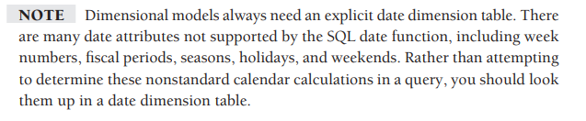
Some designers pause at this point to ask why an explicit date dimension table is needed. They reason that if the date key in the fact table is a date type column, then any SQL query can directly constrain on the fact table date key and use natural SQL date semantics to filter on month or year while avoiding a supposedly expensive join. This reasoning falls apart for several reasons. First, if your relational database can’t handle an efficient join to the date dimension table, you’re in deep trouble. Most database optimizers are quite efficient at resolving dimensional queries; it is not necessary to avoid joins like the plague. Since the average business user is not versed in SQL date semantics, he would be unable to request typical calendar groupings. SQL date functions do not support filtering by attributes such as weekdays versus weekends, holidays, fiscal periods, or seasons. Presuming the business needs to slice data by these nonstandard date attributes, then an explicit date dimension table is essential. Calendar logic belongs in a dimension table, not in the application code.

Slide 123
Flags and Indicators as Textual Attributes
Like many operational flags and indicators, the date dimension’s holiday indicator is a simple indicator with two potential values. Because dimension table attributes serve as report labels and values in pull-down query filter lists, this indicator should be populated with meaningful values such as Holiday or Non-holiday instead of the cryptic Y/N, 1/0, or True/False. As illustrated in Figure 3-6, imagine a report comparing holiday versus non-holiday sales for a product. More meaningful domain values for this indicator translate into a more meaningful, self-explanatory report. Rather than decoding flags into understandable labels in the BI application, we prefer that decoded values be stored in the database so they’re consistently available to all users regardless of their BI reporting environment or tools.

Slide 124
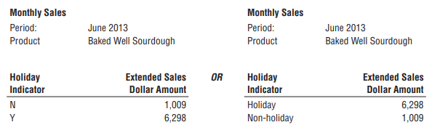
A similar argument holds true for the weekday indicator that would have a value of Weekday or Weekend. Saturdays and Sundays obviously would be assigned the weekend value. Of course, multiple date table attributes can be jointly constrained, so you can easily compare weekday holidays with weekend holidays.

Slide 125
Time-of-Day as a Dimension or Fact
Although date and time are comingled in an operational date/time stamp, time-of day is typically separated from the date dimension to avoid a row count explosion in the date dimension. As noted earlier, a date dimension with 20 years of history contains approximately 7,300 rows. If you changed the grain of this dimension to one row per minute in a day, you’d end up with over 10 million rows to accommodate the 1,440 minutes per day. If you tracked time to the second, you’d have more than 31 million rows per year! Because the date dimension is likely the most frequently constrained dimension in a schema, it should be kept as small and manageable as possible.

Slide 126
Product Dimension
The product dimension describes every SKU in the grocery store. Although a typical store may stock 60,000 SKUs, when you account for different merchandising schemes and historical products that are no longer available, the product dimension may have 300,000 or more rows. The product dimension is almost always sourced from the operational product master file. Most retailers administer their product master file at headquarters and download a subset to each store’s POS system at frequent intervals. It is headquarters’ responsibility to defi ne the appropriate product master record (and unique SKU number) for each new product.

Slide 127
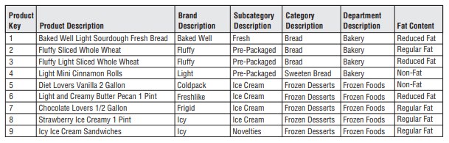
Flatten Many-to-One Hierarchies
The product dimension represents the many descriptive attributes of each SKU. The merchandise hierarchy is an important group of attributes. Typically, individual SKUs roll up to brands, brands roll up to categories, and categories roll up to departments. Each of these is a many-to-one relationship. This merchandise hierarchy and additional attributes are shown for a subset of products

Slide 128
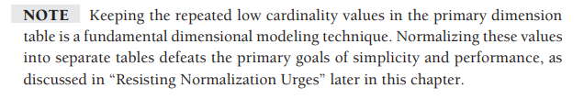
For each SKU, all levels of the merchandise hierarchy are well defi ned. Some attributes, such as the SKU description, are unique. In this case, there are 300,000 diff erent values in the SKU description column. At the other extreme, there are only perhaps 50 distinct values of the department attribute. Thus, on average, there are 6,000 repetitions of each unique value in the department attribute. This is perfectly acceptable! You do not need to separate these repeated values into a second normalized table to save space. Remember dimension table space requirements pale in comparison with fact table space considerations.
Notes:
120/601 page 85

Slide 129
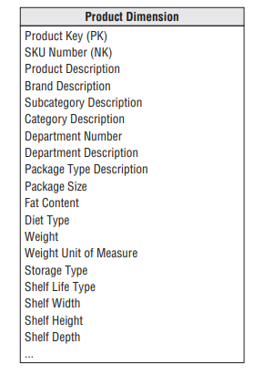

Slide 130
Attributes with Embedded Meaning
Often operational product codes, identified in the dimension table by the NK notation for natural key, have embedded meaning with different parts of the code representing significant characteristics of the product. In this case, the multipart attribute should be both preserved in its entirety within the dimension table, as well as broken down into its component parts, which are handled as separate attributes. For example, if the fifth through ninth characters in the operational code identify the manufacturer, the manufacturer’s name should also be included as a dimension table attribute.

Slide 131
Numeric Values as Attributes or Facts
You will sometimes encounter numeric values that don’t clearly fall into either the fact or dimension attribute categories. A classic example is the standard list price for a product. It’s definitely a numeric value, so the initial instinct is to place it in the fact table. But typically the standard price changes infrequently, unlike most facts that are often differently valued on every measurement event.
If the numeric value is used primarily for calculation purposes, it likely belongs in the fact table. Because standard price is non-additive, you might multiply it by the quantity for an extended amount which would be additive. Alternatively, if the standard price is used primarily for price variance analysis, perhaps the variance metric should be stored in the fact table instead. If the stable numeric value is used predominantly for filtering and grouping, it should be treated as a product dimension attribute.

Slide 132
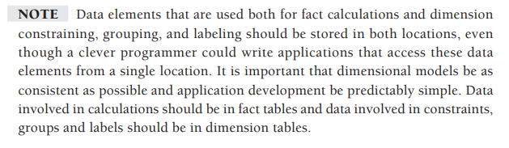
Numeric Values as Attributes or Facts
Sometimes numeric values serve both calculation and filtering/grouping functions. In these cases, you should store the value in both the fact and dimension tables. Perhaps the standard price in the fact table represents the valuation at the time of the sales transaction, whereas the dimension attribute is labeled to indicate it’s the current standard price.

Slide 133
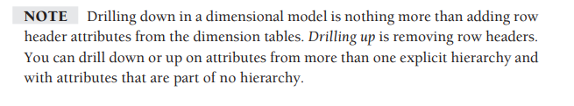
Drilling Down on Dimension Attributes
A reasonable product dimension table can have 50 or more descriptive attributes. Each attribute is a rich source for constraining and constructing row header labels. Drilling down is nothing more than asking for a row header from a dimension that provides more information. Let’s say you have a simple report summarizing the sales dollar amount by department. As illustrated in Figure 3-9, if you want to drill down, you can drag any other attribute, such as brand, from the product dimension into the report next to department, and you can automatically drill down to this next level of detail. You could drill down by the fat content attribute, even though it isn’t in the merchandise hierarchy rollup.

Slide 134
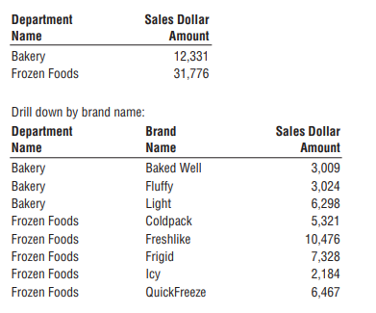
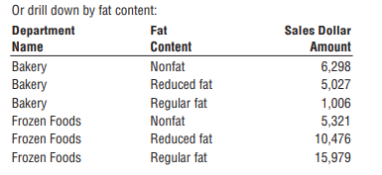
The product dimension is a common dimension in many dimensional models. Great care should be taken to fill this dimension with as many descriptive attributes as possible. A robust and complete set of dimension attributes translates into robust and complete analysis capabilities for the business users.

Slide 135
Store Dimension
The store dimension describes every store in the grocery chain. Unlike the product master file that is almost guaranteed to be available in every large grocery business, there may not be a comprehensive store master file. POS systems may simply supply a store number on the transaction records. In these cases, project teams must assemble the necessary components of the store dimension from multiple operational sources. Often there will be a store real estate department at headquarters who will help define a detailed store master file.

Slide 136

Multiple Hierarchies in Dimension Tables
The store dimension is the case study’s primary geographic dimension. Each store can be thought of as a location. You can roll stores up to any geographic attribute, such as ZIP code, county, and state in the United States. Contrary to popular belief, cities and states within the United States are not a hierarchy. Since many states have identically named cities, you’ll want to include a City-State attribute in the store dimension.
Stores likely also roll up an internal organization hierarchy consisting of store districts and regions. These two different store hierarchies are both easily represented in the dimension because both the geographic and organizational hierarchies are well defined for a single store row.

Slide 137
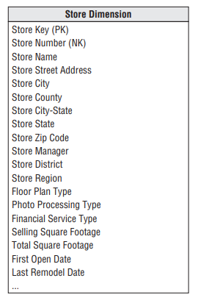
The floor plan type, photo processing type, and finance services type are all short text descriptors that describe the particular store. These should not be one-character codes but rather should be 10- to 20-character descriptors that make sense when viewed in a pull-down filter list or used as a report label.
The column describing selling square footage is numeric and theoretically additive across stores. You might be tempted to place it in the fact table. However, it is clearly a constant attribute of a store and is used as a constraint or label more often than it is used as an additive element in a summation. For these reasons, selling square footage belongs in the store dimension table.

Slide 138

Dates Within Dimension Tables
The first open date and last remodel date in the store dimension could be date type columns. However, if users want to group and constrain on nonstandard calendar attributes (like the open date’s fiscal period), then they are typically join keys to copies of the date dimension table. These date dimension copies are declared in SQL by the view construct and are semantically distinct from the primary date dimension. The view declaration would look like the following:

Slide 139
Dates Within Dimension Tables
Now the system acts as if there is another physical copy of the date dimension table called FIRST_OPEN_DATE. Constraints on this new date table have nothing to do with constraints on the primary date dimension joined to the fact table.
The first open date view is a permissible outrigger to the store dimension. Notice we have carefully relabeled all the columns in the view so they cannot be confused with columns from the primary date dimension. These distinct logical views on a single physical date dimension are an example of dimension role playing.

Slide 141
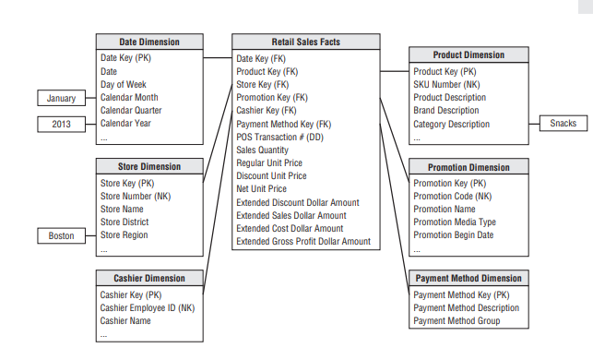
Retail schema

Slide 142
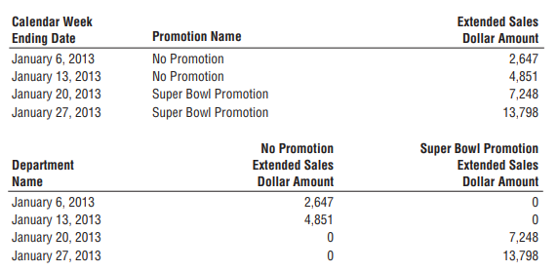
Query results

Slide 143
Factless Fact Tables
There is one important question that cannot be answered by the previous retail sales schema: What products were on promotion but did not sell? The sales fact table records only the SKUs actually sold. There are no fact table rows with zero facts for SKUs that didn’t sell because doing so would enlarge the fact table enormously.
In the relational world, a promotion coverage or event fact table is needed to answer the question concerning what didn’t happen. The promotion coverage fact table keys would be date, product, store, and promotion in this case study. This obviously looks similar to the sales fact table you just designed; however, the grain would be significantly different. In the case of the promotion coverage fact table, you’d load one row for each product on promotion in a store each day (or week, if retail promotions are a week in duration) regardless of whether the product sold.

Slide 144
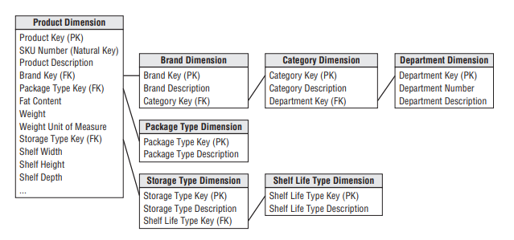
Resisting Normalization Urges
Snowflaked product dimension

Slide 145
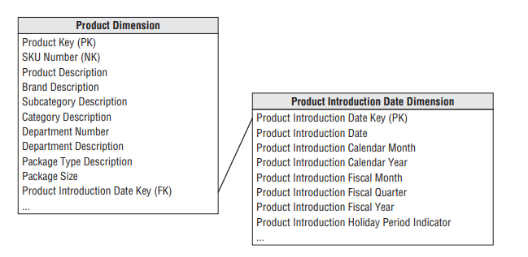

Date outrigger

